Slide 1


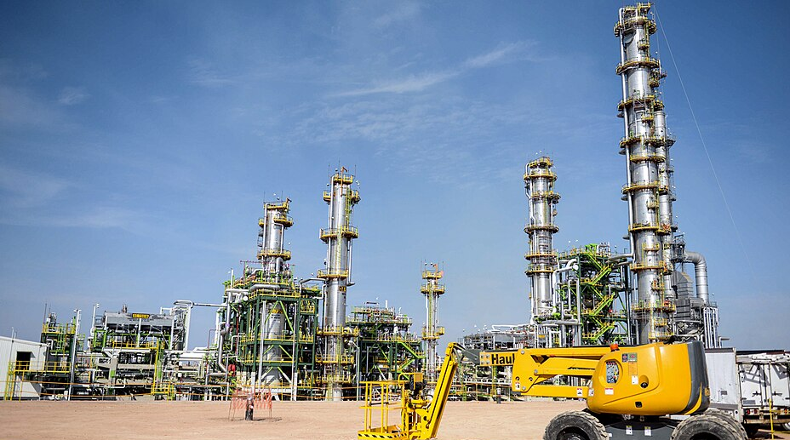
Success Story
Enterprise-Level Transformation with AMADAS + IMHub
Industry: Plant type: Project type: Scope:
Oil, Gas & Petrochemical Refining & Petrochemical Facilities Enterprise Digital Integration Analyzer Data Unification
Application
Proof of Concept (POC) implementing enterprise-level analyzer management, KPI visibility, and automated OT/IT workflows across multiple sites. Executive Summary
One of the world’s largest state-owned petroleum companies, required an enterprise-scale solution to move beyond site-level analyzer monitoring and achieve unified visibility across its refining and petrochemical operations. While AMADAS provided valuable analyzer performance insights, the lack of enterprise integration limited scalability, automation, and corporate-level decision-making. By implementing IMHub as a centralized integration layer, the company transformed analyzer operations into a unified digital ecosystem—connecting AMADAS with SAP and PACE to deliver real-time KPIs, automated workflows, and a single source of truth aligned with its Industry 4.0 roadmap.

Slide 2
Customer Challenge
Standalone AMADAS installation delivered analyzer-focused monitoring, but it did not meet corporate integration requirements. Key difficulties included:
Lack of enterprise-wide visibility: Analyzer performance data, maintenance activities, and alarms remained siloed per site, preventing enterprise KPI comparisons.
Manual workflows and disparate systems: Engineering and maintenance teams manually transferred data between AMADAS, SAP, and PACE, increasing errors and operational delays.
No single source of truth for OT/IT data: Critical analyzer metrics could not be unified with corporate IT systems for higher-level decision-making.
Inefficiencies in report generation: Operators spent significant time compiling analyzer KPIs, maintenance logs, and SQC charts due to limited automation.
Scalability concerns: With growing analyzer populations and multiple sites, the existing architecture could not scale for long-term digital transformation.
Delays and random behavior observed from various analyzers, configure analyzers by reading their values via PIOPC tags, identifying the correct PIOPC component tags among many available tags.
Solution
Enterprise Integration Architecture
IMHub was deployed as the enterprise OT/IT integration layer, aggregating data from multiple AMADAS servers and exposing analyzer KPIs, alarms, and performance metrics through secure REST APIs.
Automated Digital Workflows
IMHub’s low-code/no-code workflow engine automates analyzer validation, maintenance task creation, and job routing between AMADAS, SAP, and PACE, reducing manual intervention and data transfer errors.
Real-Time KPI Visibility
Role-based dashboards deliver real-time insights into analyzer availability, reliability, maintenance backlog, and performance trends, enabling multi-site comparison for engineering teams and enterprise leadership.
Scalable Industry 4.0 Foundation
The architecture supports hundreds of analyzers across multiple sites, providing a scalable foundation for predictive maintenance, advanced analytics, and long-term digital transformation initiatives.

Slide 3
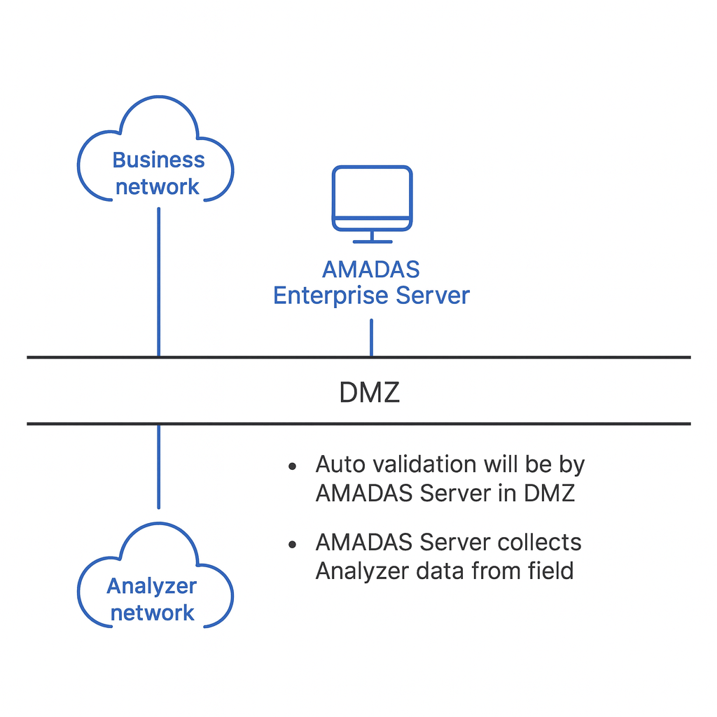

Results
The company achieved enterprise-wide analyzer visibility, reduced manual reporting effort, improved analyzer reliability, and established a scalable, integrated OT/IT platform supporting faster, more informed decision-making.
Products/Solutions Used
AMADAS (Analyzer Management & Data Acquisition System) and OpreX Intelligent Manufacturing Hub (IMHub).
Future Outlook
The AMADAS + IMHub architecture provides PEMEX with a scalable platform to expand predictive maintenance, advanced analytics, and Industry 4.0 initiatives across its enterprise.
Subject to change without notice
All Rights Reserved, Copyright © 2022, by Yokogawa Electric Corporation
YOKOGAWA ELECTRIC CORPORATION
World Headquarters
9-32 Nakacyo 2-chome, Musashino-shi, Tokyo 180-8750, Japan http’//www.yokogawa.com/

