Slide 1


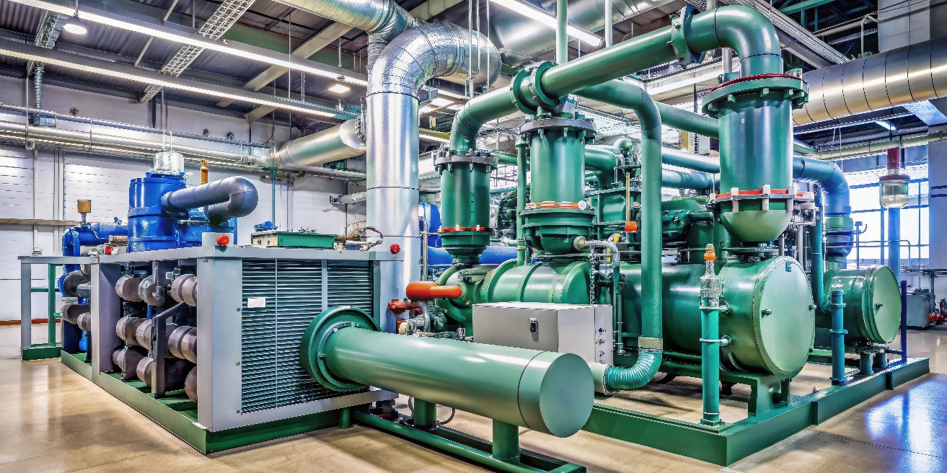
Success Story
Industrial-Grade Freeze Protection for Mission-Critical Cooling Loops
Industry: Plant type: Project type: Scope:
Multiple Industrial Industries
Cooling Systems
Primary Cooling Infrastructure & Chilled Water Lines
Freeze Protection Control
Application
In data center environments, uninterrupted cooling is paramount to preventing thermal runaway in high-density server racks. Large-scale chilled water systems are engineered to handle these immense, continuous heat loads; however, rapid load fluctuations or drops in fluid velocity can cause outdoor chiller evaporators and exposed external piping loops to plummet in temperature, risking catastrophic tube ruptures due to water expansion. To safeguard these critical assets, the Yokogawa UT35A digital indicating controller provides a robust, dual-layered freeze mitigation solution deployed directly at the chiller units and outdoor hydronic lines. By continuously monitoring low-bound process variables via high-accuracy RTDs or thermocouples on evaporator barrels and exposed piping skins, the UT35A serves as a dependable fail-safe, capable of interlocking chiller compressors or activating localized immersion heaters and heat-trace elements before fluid temperatures reach a critical freezing threshold.
Executive Summary
What sets the UT35A apart in high-availability data center applications is its integrated Heater Break Alarm (HBA) capability, which transforms passive freeze protection on outdoor equipment into an active, self-diagnostic system. Utilizing a direct current transformer (CT) input, the controller constantly validates the electrical integrity of the backup heating circuits, immediately detecting element burnouts, tripped breakers, or short-circuited solid-state relays. This proactive monitoring ensures that the freeze-mitigation system is fully operational long before an environmental freezing hazard occurs. By seamlessly routing these real-time diagnostic alarms to the facility's Building Management System (BMS) or Data Center Infrastructure Management (DCIM) platform, the UT35A minimizes the risk of catastrophic hardware damage, eliminates costly downtime, and protects the continuity of data center operations.
4

Slide 2
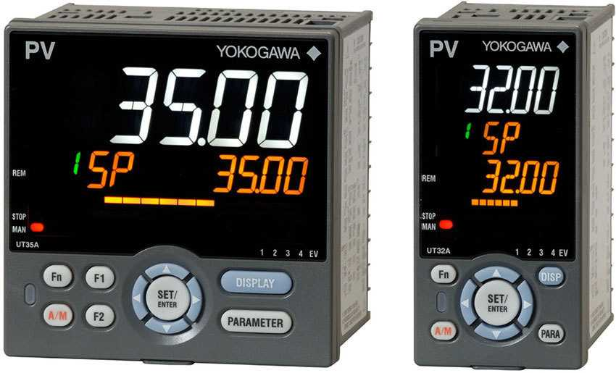

Solution
The primary architecture of the Yokogawa solution performs three core functions:
1. Precision Temperature Control
Responsive Thermal Tracking: The controller provides localized, dynamic PID control, regulating loop output to keep fluid temperatures consistently and safely above the freeze protection threshold.
Direct, High-Accuracy Inputs: Connects directly to dual-element RTD or thermocouple sensors on critical heat exchanger surfaces and pipe walls to capture real-time temperature shifts instantly.
2. Freeze-Protection Logic and Advanced Alarming
Proactive Mitigation: Automatically transitions from passive monitoring to active freeze prevention as thresholds approach, initiating interlocks, permissive logic, and output adjustments.
Dual Outputs & Visual Alerts: Simultaneously drives analog and digital outputs to force bypass valves open and activate heat-trace elements. In a crisis, the active-color LCD screen flashes from white to red for instant field visibility.
3. Simplified Local Control Architecture
Single-Unit Execution: Built-in ladder logic (up to 500 steps) combines sequence control and PID tuning into one device, eliminating the need for external timers, discrete components, or auxiliary PLCs.
Edge Autonomy with Open Integration: Functions as a standalone, zero-latency safety layer while using native Modbus/TCP or BACnet protocols to feed real-time diagnostics, loop statuses, and alarms upstream to the primary BMS..
Products Used
UTAdavanced Industrial Controllers
Advanced PID control, ladder sequence control and fuzzy logic
Function block programming
Bright and easy to read color LCD displays with scrolling text
Multiple communications protocols, Ethernet, Modbus, PROFIBUS, CC-Link, DeviceNet
NEMA 4 face
Customer Quote
“What made this solution valuable was not just the controller itself, but the complete packaged approach. The integrated controller, CT, RTD, and wiring created a plug-in heat trace control kit that helped us reduce installation complexity, verify system operation, and keep pace with high-volume production demand.”
— Thermal Systems engineer at an Original Equipment Manufacturer (OEM) specialized in design, simulate, and optimize the physical water-cooled or air-cooled chiller systems to maximize efficiency for data center deployments.
About Yokogawa
Founded in 1915, Yokogawa Electric Corporation is a global leader in industrial automation, measurement, and control solutions. For the data center industry, Yokogawa delivers advanced OT (Operational Technology) sensing, high-precision thermal monitoring, and utilities optimization solutions. By transforming traditional cooling management into highly autonomous, data-driven systems, Yokogawa helps operators mitigate the extreme thermal demands of AI and high-density compute workloads while maximizing energy efficiency and uptime.
Subject to change without notice
All Rights Reserved, Copyright © 2022, by Yokogawa Electric Corporation
YOKOGAWA ELECTRIC CORPORATION
World Headquarters
9-32 Nakacyo 2-chome, Musashino-shi, Tokyo 180-8750, Japan http’//www.yokogawa.com/

